Slide 1
Marketing Predictive Analytics
Dr. Upender Subramanian
MKT/BUAN 6337

Slide 2
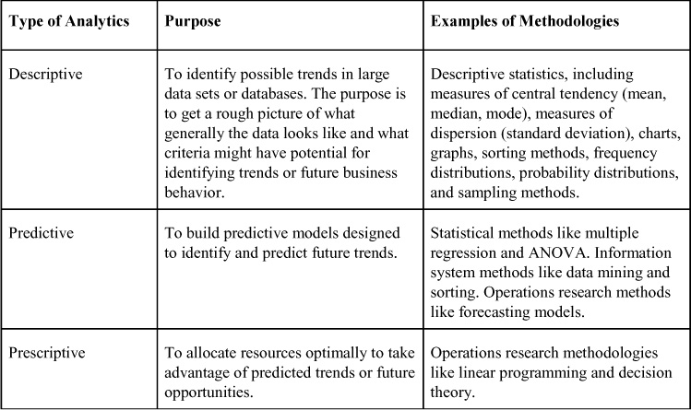
What is Predictive Analytics?
Notes:
This slide provides a general typology of the three main types of analytics
Descriptive analytics – includes exploratory analysis. It is an important step to understand the data that you have. Whether it is suitable for the questions that you want to answer and the analysis that you intend to perform. (Example1: What is the outcome variable of interest? What are the variables whose effects you are predicting? How was the data for these variables collected – random sampling, controlled studies, observational data? Example2: is there enough INDEPENDENT variation in the variables whose effects you are interested in predicting?). If there are some limitations and whether and how these limitations can be overcome (More often than not, the right solution is to design a controlled study. But if this is not possible, what is the best you can do with the data? What are the limitations?) What additional data might you need.
Predictive analytics – involves model building and estimation. A model is an approximation of the relationship between an outcome variable and a set of predictor variables that the manager is interested in – example the relation between sales (outcome) and price and advertising.
Building a model means that you are specifying the relationship between these variables in a general form. Then you have to calibrate this model for the specific data that you have so that the model is able to explain the relationship not in a general form but for the data that you have – this is known as model estimation.
Sometimes you are interested in just knowing what this relationship is. More often you are interested in using the model to predict the outcome if one or more of the predictor variables are changed – example what will happen to sales if the manager runs a promotion where the price is 10% lower, and advertising is 20% higher.
The type of model that will be used is based on the type of outcome variable, the type of relationship between the outcome and predictor variables, knowledge and assumptions about how the data was collected. So this step builds on what you have learned in the previous step – descriptive analytics.
Then applying suitable statistical methods you estimate the model from the available data. This will be the focus of this course.
If you are taking the econometrics course – you will see that this course spends more time on applying the statistical methods to marketing applications, whereas the econometrics course spends more time on the concepts and theories behind these statistical methods.
(Usually we say that the model is estimated from the data – then the estimated model is used to make predictions for different values of the predictor variables that the manager is interested in. )
Prescriptive analytics – is needed when you need more than a simple model-based prediction. For example, it is not enough to tell the manager what will happen if price is cut by 10%. But instead, you need to tell the manager what is the right price to set – could be higher or lower than the current price. So how will you do this. First, you estimate a model of the relationship between sales and price - which is the previous step. Usually the manager is interested in profit. If you know sales and the price, then you can calculate revenues. If you also know the cost, then you can calculate profit. So now you are able to predict the profit for different prices – and then by comparing the profit at different prices you can determine what is the best price. So that is a simple example of prescriptive analytics. You can have much more complex examples, where you simultaneously use multiple predictive models and combine their predictions in a suitable manner to make he final recommendation. For example, how to allocate your advertising budget across different media channels and products. The first step here would be to estimate the relationship between sales and advertising level for each product in different media channels. Then, you have to combines these models to decide what is the best allocation of budget across products and channels to maximize overall revenues or profit.

Slide 3
Why Marketing Analytics?
Marketing is perhaps the most important function of any company; drives rest of business strategy
Competition puts constant pressure to defend and grow business
Increase in data collection and processing ability has created huge opportunity for analytics-driven marketing
There is huge and sustained demand for well-trained professionals in marketing analytics
Notes:
Company cannot exist without customers. Marketing deals with how to acquire, retain and grow customers

Slide 4
What is the Skillset Needed?
Math – Algebra, Equations, Probability, Statistical methods
Computer science – Data structures, algorithms, programming
Marketing domain knowledge – Marketing concepts, terminologies, decision making process
Analytics problems rarely present themselves as a regression problem or machine learning problem
Analyst must figure out what data to use and what analysis to perform to answer the marketing problem, and interpret and present results to the marketing manager
Notes:
Marketing domain knowledge – more of a soft skill.

Slide 5
Course Objectives
Marketing concepts and decision-making problems
Properties and limitations of marketing data
Actionable analytics insights for marketing
Model building and prediction for marketing problems
Interpreting results for marketing audience
SAS programming and analytics

Slide 6
Course Prerequisites
Good understanding of basic statistics
Probability distribution, histograms, contingency tables
Mean, median, mode, standard deviation, correlation
Hypothesis testing, Type I and Type II errors, p-value, two-tailed and one-tailed tests, confidence interval
Statistical tests for comparing two sample means, two sample proportions, correlation and independence
Required: OPRE 6301, Recommended: BUAN 6312
Motivation to learn programming and SAS analytics from published materials (books, websites) and each other (elearning discussion forum)

Slide 7
Overview of Marketing and Role of Analytics
Notes:
Need to know the end application for which you are developing the model. And marketing as an application has some peculiarities and concepts that you need to know as an analyst. And we will talk about that today.

Slide 8

What is Marketing?
New products
Pricing
Deals & Promotions
Advertisements
Website layout

Slide 9
What is Marketing?
New products
Pricing
Deals & Promotions
Advertisements
Website layout
Marketing
Decision-Making Framework
Understanding What Influences
Buyer Behavior

Slide 10
A Definition of Marketing
Marketing = Process of
a) Understanding consumers +
b) Understanding competitive environment +
c) Also how these two interact
to design a marketing program that will…
influence consumer behavior…
to achieve a desired result
Notes:
Marketing analytics can help understand how different marketing decisions will influence consumer behavior and if they will lead to the desired result
For example will cutting price or increasing advertising help?

Slide 11
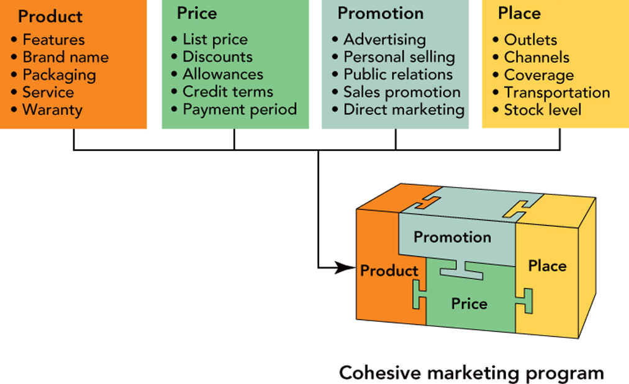
Marketing Program / Mix (4P’s)
Marketing Program (aka Marketing Mix): Factors under the business’ control to influence buyers’ decisions
Notes:
Predictive analytics can help decide optimal marketing program

Slide 12
How Can Predictive Analytics Help?
Basic idea is Response Modeling
If firm takes Marketing Action X, predict how it will affect Market Response Y, given all other Market Factors Z
If Dell allocates 50 more sales people to DFW, how much will sales in this territory increase by?
If Amazon increases price of Echo from $79 to $99, how much will sales decrease by?
If AT&T offers free HBO to TV customers canceling their subscription, how much will it reduce churn?
If IKEA sends weekly promotional emails to its customers, how many more will visit the store? How much will they spend? How will it affect customers who would have anyway bought?

Slide 13
Sources of Marketing Data
Attitudinal data
Surveys: Customer satisfaction, Product / brand evaluation
Online reviews, Facebook, Twitter posts
Behavioral data
Purchase or consumption: sales, purchase baskets, renewals, usage, webpage viewing and click-stream
Aggregate level or individual level
Field Studies
Before-After studies, A/B testing

Slide 14
Types of Response Models
Surveys – Structured data
Multivariate analysis (multiple response variables)
Cluster analysis, Factor analysis, Multidimensional scaling
Online reviews, comments – Unstructured data
Text analysis, Sentiment analysis, Word associations
Behavioral data – Revealed preference
Choice models, Censored regression
Field Studies – Causal Inference
Observed and unobserved factors that also affect outcome

Slide 15
Types of Analysis
Depends on type of response Y being predicted, type of data available on X and Z
Continuous response variables: multiple linear regression
Robust standard errors: heteroscedasticity
Fixed effects, random effects: repeated observations, panel data
Time series: lag effects, repeated observations
Tobit: Truncated data, Selection models: Censored data
Categorical response variables: Logistic regression
Multinomial: multiple (> 2) categorical outcomes
Survival analysis to model durations (e.g., time to next purchase)
Notes:
So this is all about response modeling in different situations.. We will get into more details in future clases.
But there’s an additional level of complexity that needs to be thought about when it comes to marketing. In basic response modeling – we are talking as though there is one type of product or price or promotion that you can offer all consumers. But that is not how marketing works in practice.

Slide 16
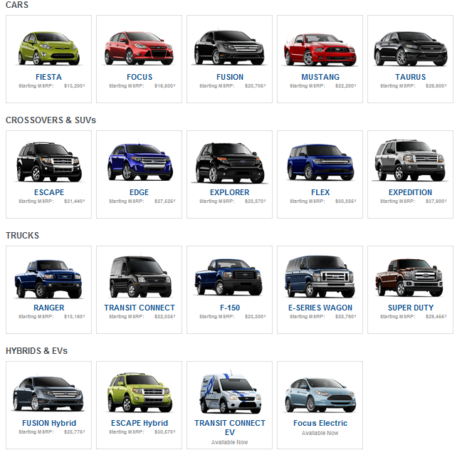
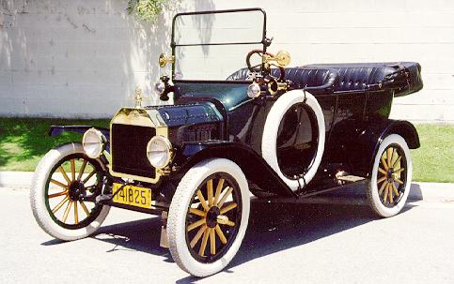
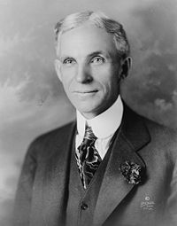
Marketing is NOT One Size Fits All
Ford in 2010
Ford in 1910
“Any customer can have a car painted any color that he wants so long as it is black”
Why??? Because different consumers have different needs and preferences, not all consumers are the same
Notes:
Why did ford do this ? Why was he successful? Why can it not afford to do this anymore?
This is one of the most important ideas to know about marketing – because it has important implications for how you develop response models. So we will digress a bit from response modeling to understanding marketing and how marketing deals with this idea that not all customers are the same. Because every analyst needs to understand the end application for which you are developing a model.

Slide 17
Marketing is NOT One Size Fits All
Companies are able to customize their marketing mix (products, price, promotions, place) to an amazing degree
What products should Amazon display on its landing page?
What ads should be shown on NY Times?
What offers should Groupon email every day?
What price should Uber charge for a ride?
Notes:
In each example – you need to also ask for whom? there is an abundance of data available about existing consumers. So that you can optimize the marketing mix to these consumers
And some data that is available even for new consumers. You can try to figure out which existing consumers the new consumers most resemble.

Slide 18
Not All Customers are the Same
In marketing, there is a well-developed approach to incorporate this important fact into marketing decisions
Three key steps in this approach:
Discover and Profile Market Segments
Select Target Segments
Develop Positioning for each Target Segment
This approach affects all marketing decisions and activities: a marketing program is designed for each target segment
Notes:
Marketing also uses a very specific set of terms and approach to tackle this idea that not all consumers are the same (wrt their needs and preferences)
We will talk about this approach today

Slide 19
Definitions: Market Segments
For many products, market consists of different types of buyers with very different needs and preferences
More useful to consider subsets of potential buyers with a common need or common response to marketing actions; this is a customer segment
Market (Potential Buyers)
Common Needs / Response
Segment A
Segment B
Segment C
Segment D
Notes:
Segments are very fundamental and crucial unit of analysis in marketing – all marketing decisions are usually made at level of segments

Slide 20
Example for Dell Computers
Market | Segment Name | Underlying Need | Typical Characteristics | Product
C O N S U M E R S | Gamers | Play very involved, graphic-intensive games | 20 – 30s, male, tech geeks | Gaming machine
 | Social Networkers | Chat, IM, Tweet, Text, Facebook | Younger and older Teens, | Tablet
 | Media & Entertainment | Store music, videos, watch TV | Netflix / Hulu customers | Smart TV
.
.
.
.
.
.
.
.
.
.
.
.
.
.
.
What could be market segments for Apple iPhone? for Honda Cars? What might be characteristics of customers in these segments?

Slide 21
Why Segment Based on Need / Response?
Difficult otherwise to design common product or marketing program that appeals to all consumers in a segment
Consumers in same segment have similar needs / response
Naturally means that different segments need different products / marketing programs (not one size fits all)
Consumers in different segments have dissimilar needs / response
IMPORTANT: Identify typical characteristics of consumers in a segment ONLY AFTER you segment based on need/response
Characteristics should not be the basis for segmenting the market
Notes:
Why not segment by product or revenues or customer characteristics?

Slide 22
Implication for Analytics
Segments add a new dimension to response modeling => Must develop separate response model for each segment
Not one model fits all, leads to incorrect / poor predictions
In addition, analytics can be used to
=> Discover / validate segments
Segments may not be pre-defined or may be incorrectly defined
=> Identify typical characteristics of consumers in each segment (useful to target consumers in each segment)
Demographical or behavioral characteristics
=> Identify most likely segment a consumer belongs to (useful to customize marketing actions to that consumer)
Notes:
If you had the data for each segment → then build a separate response model for each.
You could also use the data to validate whether the segmentation is correct, identify new segments or modify the segmentation scheme.

Slide 23

Definitions: Target Segments
Market (Potential Buyers)
Common Needs / Response
Segment A
Segment B
Segment C
Segment D
Target Segments
Target Segments: Specific segments towards which a business directs its marketing program
e.g. “Gamers” are a target segment for Dell: www.alienware.com
Analytics can identify which segments are worthwhile to target
Notes:
Lets continue with the marketing concepts. The next concept is target segments.

Slide 24



Definitions: Positioning
Positioning: In the minds of the buyers in the target segment…
…how well does your product meet their needs, relative to other alternatives
Consumers have several options. Why should they buy your product, instead of the competitor’s?
Related concepts: Value Proposition, Differentiation
Gamers

Slide 25
Positioning is Crucial in Marketing
Example: What is the positioning of Apple iPhone vs. Samsung Galaxy? Which one is better?
Success or failure of product depends on how well the product is positioned (in the minds of the buyer)
Must offer better (perceived) value than other products for a sizable number of consumers
Analytics helps understand how consumers perceive different brands, their willingness to pay for different products and features
Notes:
More useful to know what types of consumers will prefer the iPhone vs. what types of consumers will prefer the Galaxy vs. … neither

Slide 26
Marketing Program / Marketing Mix
Market (Potential Buyers)
Common Needs / Response
Segment A
Segment B
Segment C
Segment D
Target Segments
Marketing Program for Target Segment B
Product
Promotion
Place
Price
Marketing Program for Target Segment C
Product
Promotion
Place
Price

Slide 27
Marketing Decision Framework
Analytics can support each step of this process
Strategy Implementation: Marketing Mix
4 P’s: Product, Pricing, Place, Promotion
Marketing
Analytics
Marketing Strategy
STP: Segmentation, Targeting, and Positioning
Understanding Buyer Behavior
Notes:
Understanding buyer behavior and discovering segments allows businesses to decide the right target segments and successful positioning for their products

Slide 28
Marketing Decisions Affected by Analytics
Marketing Mix Decisions
Product (what features, versions)
Price (what price, which customers)
Promotions (when, for whom, what type)
Advertising (what, where, how often)
Sales force (how many, what products and territories)
Buying Behavior, Segmentation, Targeting, Positioning
What do consumers want? How do they perceive diff brands?
How are consumers similar or different in what they want?
Which consumer segments to target?
What value proposition to offer? What is the positioning?

Slide 29
Summary
Marketing predictive analytics involves response modeling as the basic step
Nature and source of available data drive type of analysis
In addition, one must explicitly incorporate the fact that not all customers are the same => respond differently
Analytics can be used to discover segments, analyze segments, as well as explicitly incorporate segmenting variables in the analysis

